Slide 1

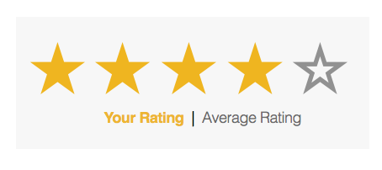
PROJECT PRESENTATION
ON
RATING PREDICTION
BY
V SAMYUKTA
This Photo by Unknown Author is licensed under CC BY-NC

Slide 2
CONTENT
Overview.
Problem Understanding.
What is Rating Prediction?
Importance of Rating prediction. Problem Statement.
Exploratory data analysis.
Visualizations.
Analysis.
Model Building.
Hyper Parameter Tunning.
Conclusion.

Slide 3
OVERVIEW:
In this presentation we will be looking at :
How to analyze the dataset of Rating Prediction Project.
What are the EDA steps in cleaning the dataset.
Overall analysis on the problem.
Model building from cleaned dataset.
Predicting Used Car Price for saved best model.

Slide 4
PROBLEM STATEMENT:
We have a client who has a website where people write different reviews for technical products. Now they are adding a new feature to their website i.e. The reviewer will have to add stars(rating) as well with the review. The rating is out 5 stars and it only has 5 options available 1 star, 2 stars, 3 stars, 4 stars, 5 stars. Now they want to predict ratings for the reviews which were written in the past and they don’t have a rating. So, we have to build an application which can predict the rating by seeing the review.

Slide 5
PROBLEM UNDERSTANDING:
Rating prediction is a well-known recommendation task aiming to predict a user’s rating for those items which were not rated yet by her. Predictions are computed from users’ explicit feedback, i.e. their ratings provided on some items in the past. Another type of feedback are user reviews provided on items which implicitly express users’ opinions on items. Recent studies indicate that opinions inferred from users’ reviews on items are strong predictors of user’s implicit feedback or even ratings and thus, should be utilized in computation.

Slide 6
What is Rating Prediction?
Rating prediction is a well-known recommendation task aiming to predict a user's rating for those items which were not rated yet by her. Predictions are computed from users' explicit feedback, i.e. their ratings provided on some items in the past.

Slide 7
IMPORTANCE OF MALIGANT COMMENT CLASSIFIER
The rise in E-commerce has brought a significant rise in the importance of customer reviews. There are hundreds of review sites online and massive amounts of reviews for every product. Customers have changed their way of shopping and according to a recent survey, 70 percent of customers say that they use rating filters to filter out low rated items in their searches. The ability to successfully decide whether a review will be helpful to other customers and thus give the product more exposure is vital to companies that support these reviews, companies like Google, Amazon and Yelp!. There are two main methods to approach this problem. The first one is based on review text content analysis and uses the principles of natural language process (the NLP method). This method lacks the insights that can be drawn from the relationship between costumers and items. The second one is based on recommender systems, specifically on collaborative filtering, and focuses on the reviewer’s point of view.

Slide 8
EXPLORATORY DATA ANALYSIS:
Importing necessary libraries and loading dataset as a data frame.
Checked some statistical information like shape, number of unique values present, info, null values, value counts etc.
Checked for null values and I replaced those null values using imputation method. And removed Unnamed: 0.
Visualized each feature using seaborn and matplotlib libraries by plotting distribution plot and wordcloud for each ratings.
Done text pre-processing techniques like Removing Punctuations and other special characters, Splitting the comments into individual words, Removing Stop Words, Stemming and Lemmatization.
After getting a cleaned data used TF-IDF vectorizer. It’ll help to transform the text data to feature vector which can be used as input in our 6 modelling. It is a common algorithm to transform text into numbers. It measures the originality of a word by comparing the frequency of appearance of a word in a document with the number of documents the words appear in. Mathematically, TF-IDF = TF(t*d)*IDF(t,d)

Slide 9
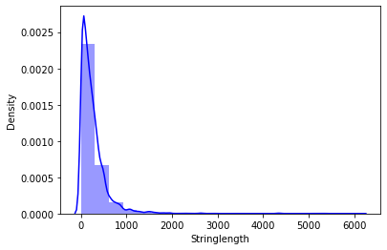
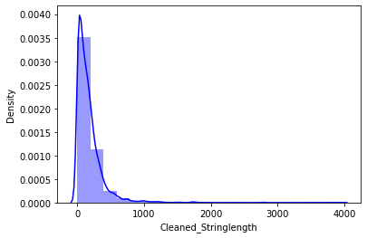
VISUALIZATION OF NUMERICAL COLUMNS:

Slide 10
OBSERVATIONS:
By observing the histogram we can clearly see that most of our text is having the number of words in the range of 0 to 500, But some of the reviews are too lengthy which may act like outliers in our data.
Above plot represents histogram for character count of Review text, which is quite similar to the histogram of word count.

Slide 11
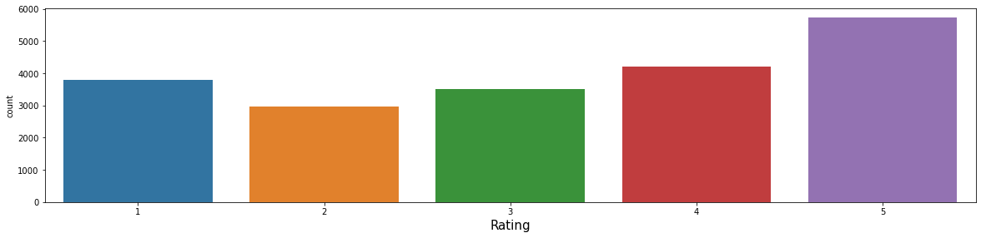
VIZUALIZATION OF CATEGORICAL COLUMNS:

Slide 12
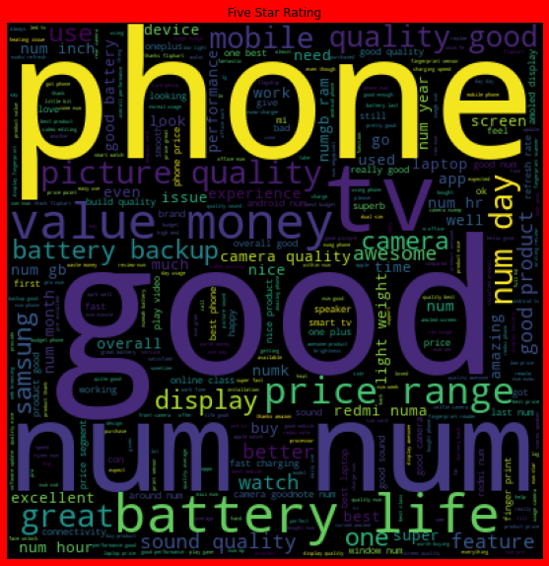
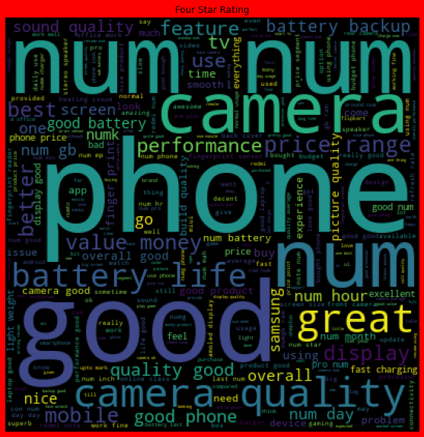
VIZUALIZATION OF CATEGORICAL COLUMNS:

Slide 13
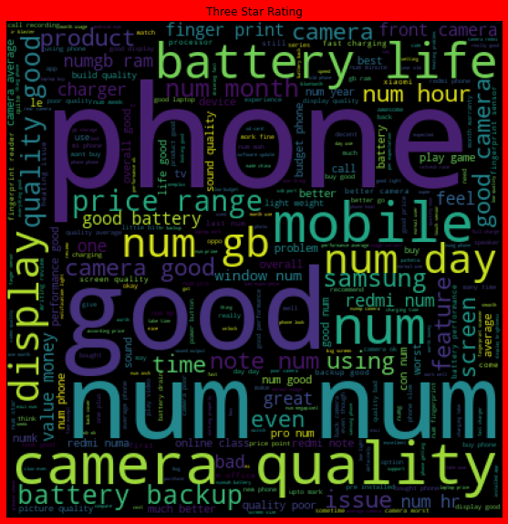
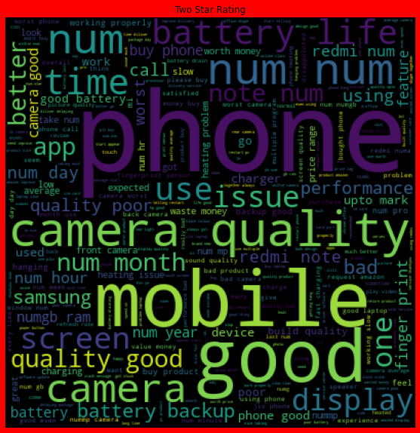
VIZUALIZATION OF CATEGORICAL COLUMNS:

Slide 14
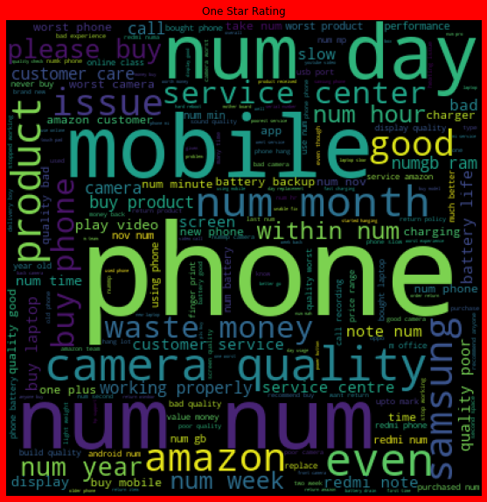
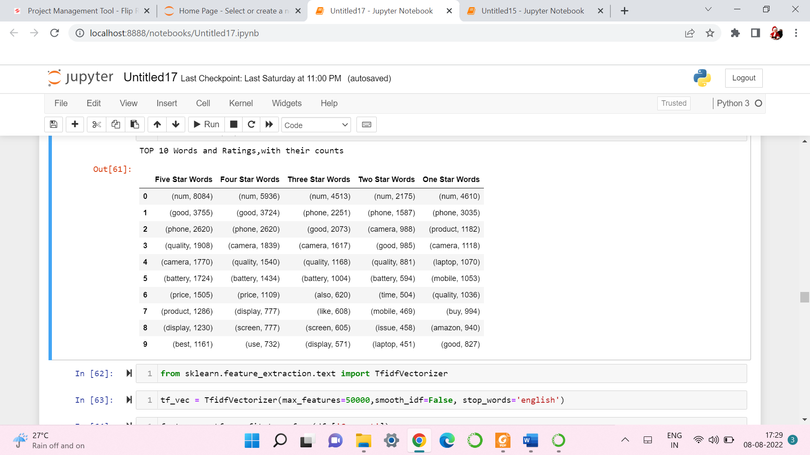
VIZUALIZATION OF CATEGORICAL COLUMNS:

Slide 15
OBSERVATIONS:
The length of most of the comments were between 0 to 800 before cleaning the data. After cleaning data, it came down to between 0 - 500
From the graphs above the following observations are made: • Reviews corresponding to 5.0 rating frequently carry words like: ‘good’, ’excellent’,’ quality’, ‘value money’ etc indicating very high customer satisfaction and high quality product. • Reviews corresponding to 4.0 rating frequently carry words like: ‘good’,’ great’, ’performance’, ’features’, ‘quality’, ’price’ etc indicating high customer satisfaction and good quality product. • Reviews corresponding to 3.0 rating frequently carry words like: ‘good’, ’well’, ’average, ’quality’, ’issue’ etc indicating customer dissatisfaction and average to below average product quality. • Reviews corresponding to 2.0 rating frequently carry words like: ‘problem’, ‘bad’, ’issues’, ’waste money’, ’poor quality’ etc indicating high customer dissatisfaction and below average product quality. • Reviews corresponding to 1.0 rating frequently carry words like: ‘stopped’, ’working’, ’cheap’, ’return’, ’issue’, ’waste money’, ’poor quality’,’ customer care’, ’bad’, ‘poor build quality’ etc indicate very high customerdissatisfaction and poor quality product.

Slide 16
ANALYSIS:
This project is more about exploration, feature engineering and classification that can be done on this data. Since the data set is huge and includes multiclassification of ratings, we can do good amount of data exploration and derive some interesting features using the review text column available.
Just make the reviews more appropriate so that we’ll get less word to process and get more accuracy.
Removed extra spaces, converted email address into email keyword, likely wise phone number etc. Tried to make Reviews small and more appropriate as much as it was possible.
After getting a cleaned data used TF-IDF vectorizer. It’ll help to transform the text data to feature vector which can be used as input in our modelling. It is a common algorithm to transform text into numbers. It measures the originality of a word by comparing the frequency of appearance of a word in a document with the number of documents the words appear in.
Balanced the data using SMOTE mechanism.

Slide 17
MODEL BUILDING:
In this nlp based project we need to predict ratings which are multiclassifiers. I have converted the text into vectors using TFIDF vectorizer and separated our feature and labels then build the model using One Vs Rest Classifier. Among all the algorithms which I have used for this purpose I have chosen Random Forest Classifier as best suitable algorithm for our final model as it is performing well compared to other algorithms while evaluating with different metrics I have used following algorithms and evaluated them
MultinomialNB
LogisticRegression
RandomForestClassifier
AdaBoostClassifier
PassiveAggressiveClassifier
ComplementNB
From all of these above models RandomForest Classifier was giving me good performance.

Slide 18
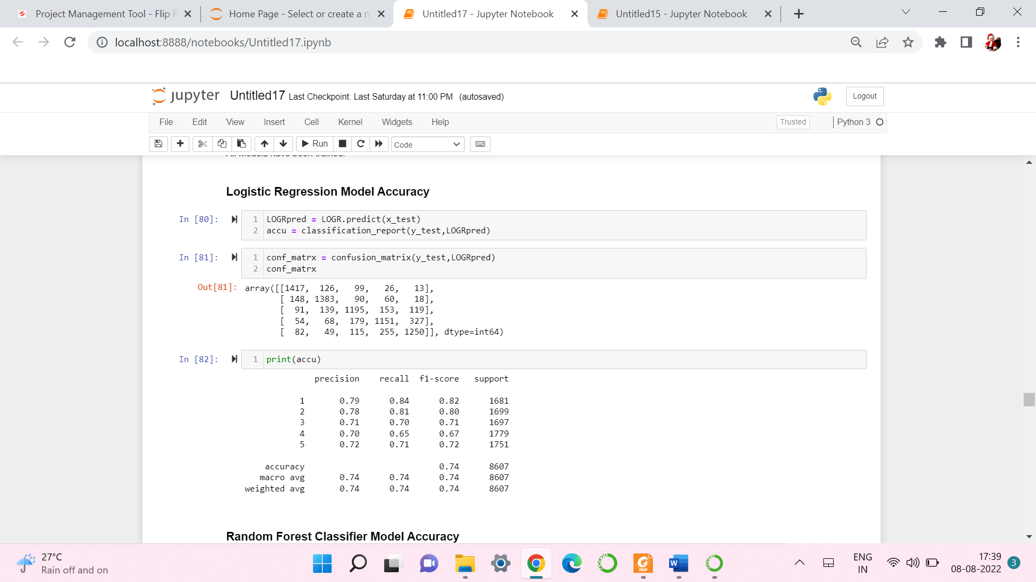
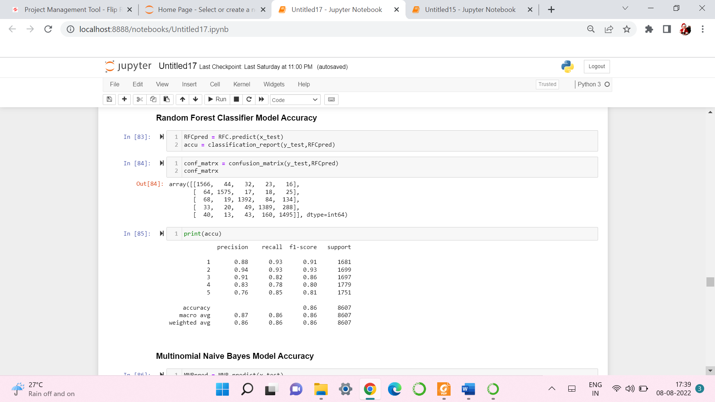

Slide 19
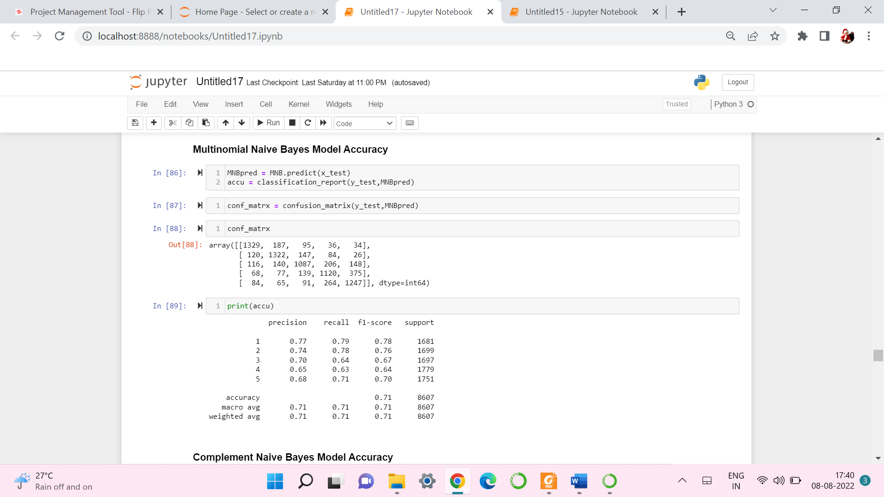
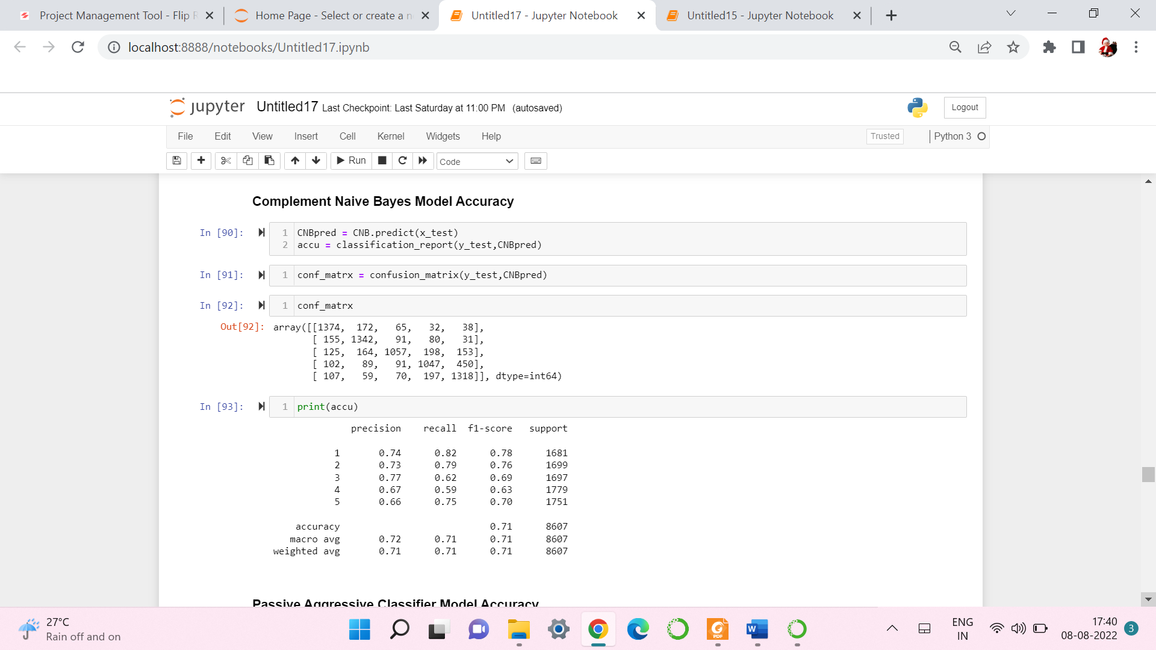

Slide 20
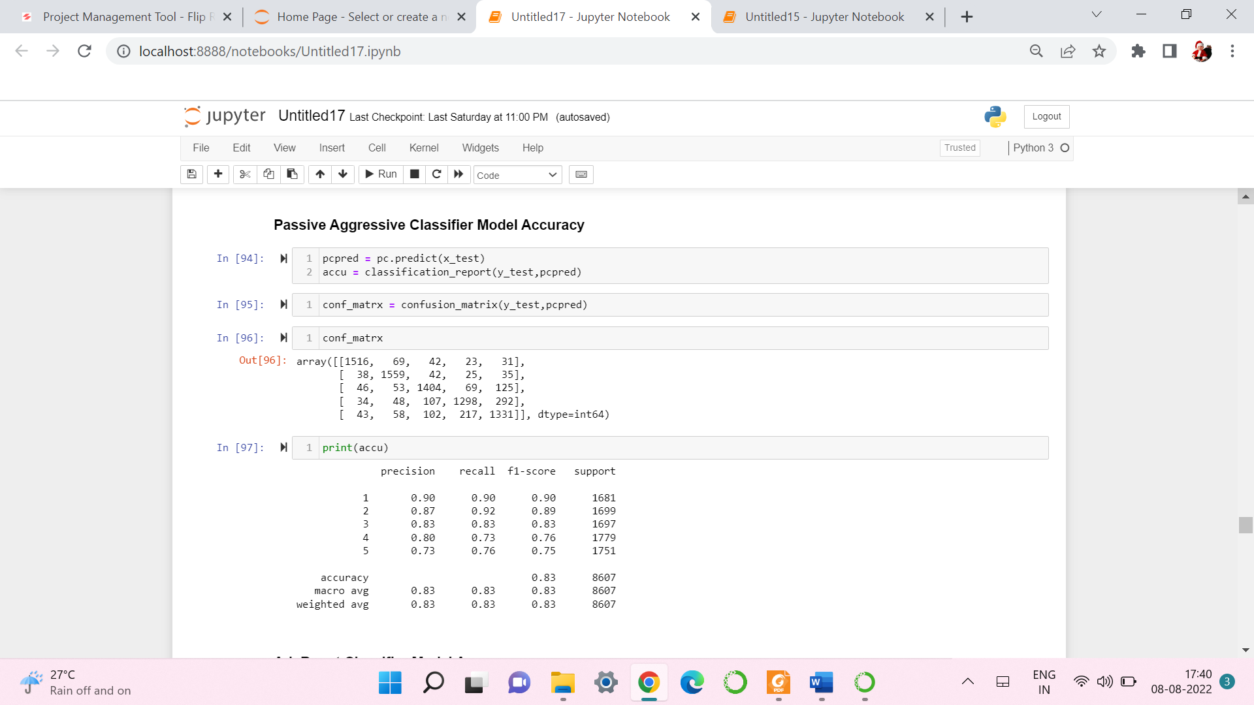
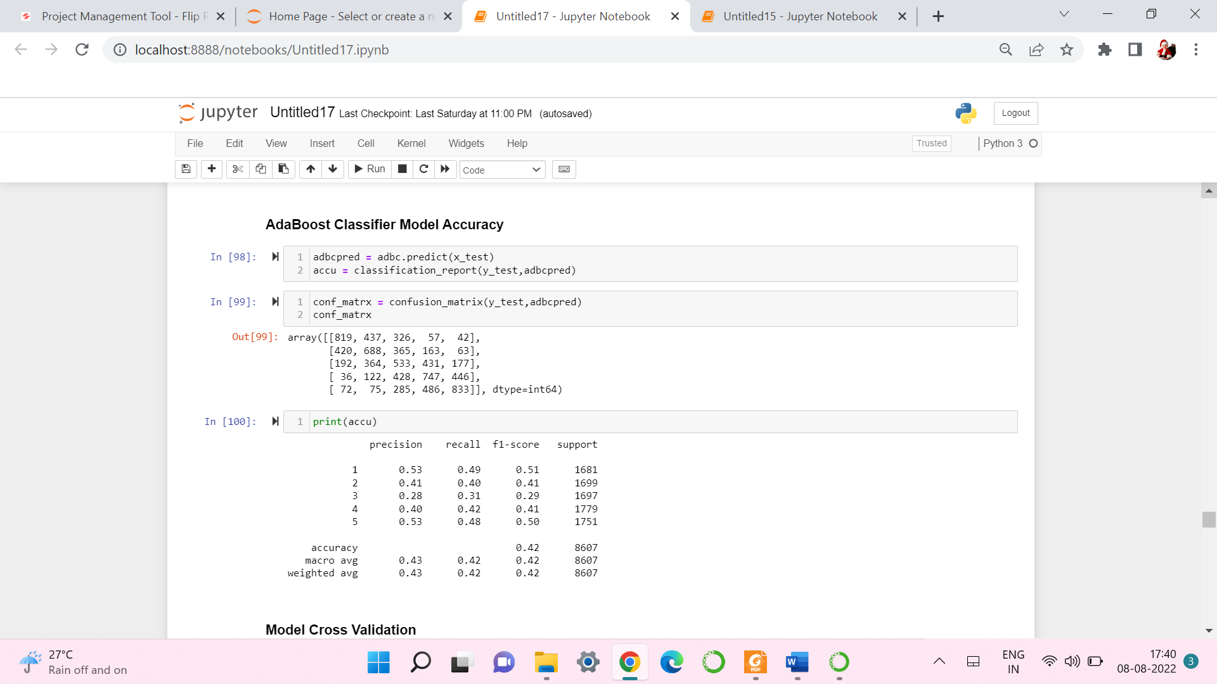

Slide 21
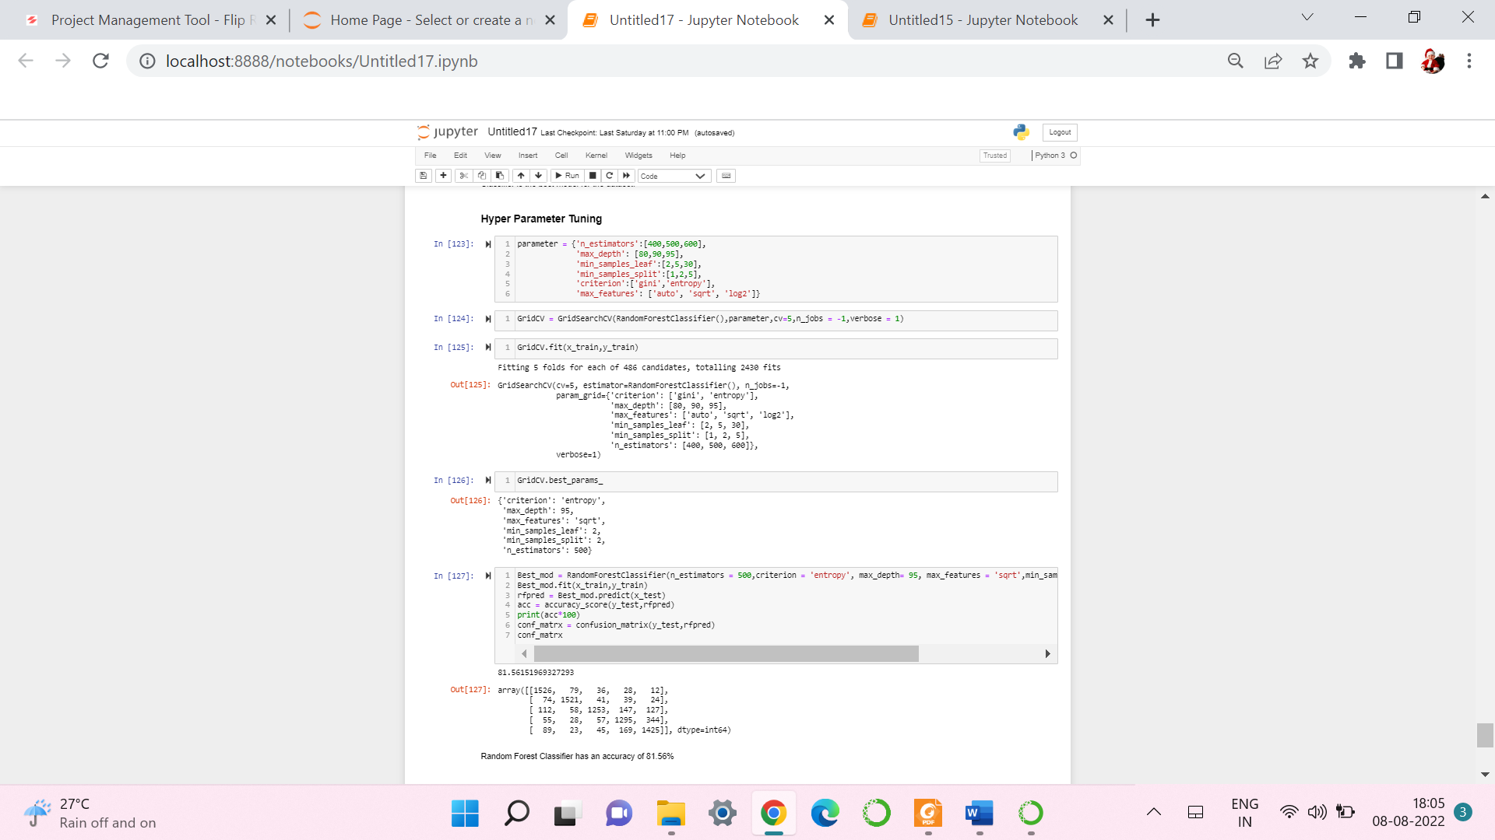
HYPER PARAMETER TUNNING:

Slide 22
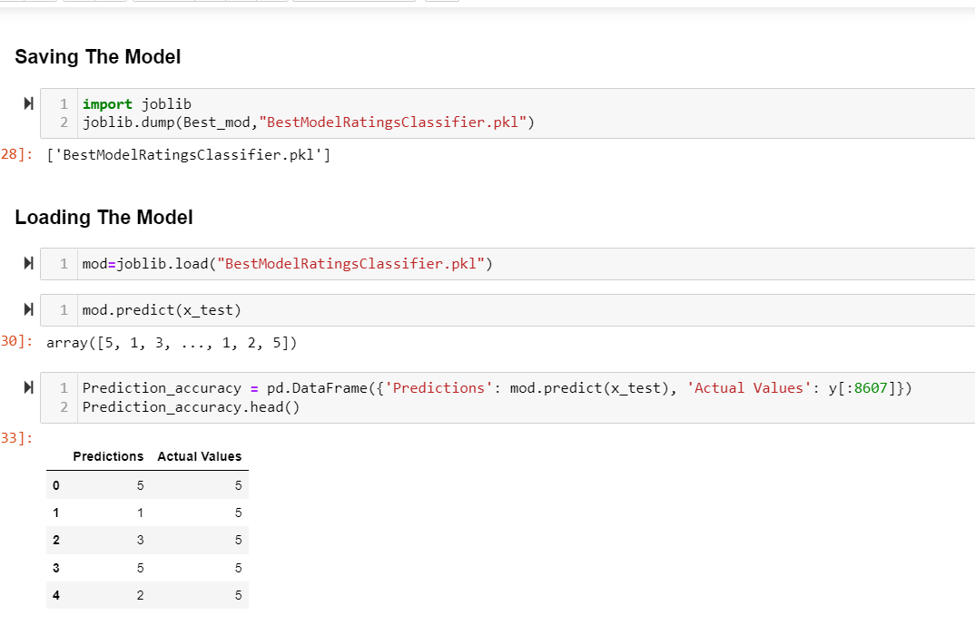
SAVING THE MODEL AND PREDICTIONS USING SAVED MODEL:
I have saved my best model using .pkl as follows.
Now after saving the best model, loading my saved model and predicting the test values.

Slide 23
CONCLUSION:
In this project report, we have used NLP machine learning algorithms to predict the Ratings. We have mentioned the step by step procedure to analyse the dataset and finding the correlation between the features.
Thus we can select the features which are correlated to each other and are independent in nature. The power of visualization has helped us in understanding the data by graphical representation it has made me to understand what data is trying to say.
Data cleaning is one of the most important steps to remove unrealistic values and unnecessary punctuations, urls, email address, stop words.
These feature set were then given as an input to 6 algorithms and a hyper parameter tunning was done to the best model. Hence we calculated the performance of each model using different performance metrics and compared them based on these metrics.
Then we have also saved the best model.

Slide 24


